Slide 1
Rodowo invites you

Slide 2
Rodowo

Slide 3
A short note
Rodowo came into existence about 1285, at that time it was the Stanges’ property.
The XV wars destroyed Rodowo.
In 1570 the village became a property of the prince Wenzel Schack von Stangenberg. The village stayed in possession of this family for 200 years. .

Slide 4
Beautiful nature

Slide 5
Green Rodowo

Slide 7
the lake

Slide 9
St.Stanislaus Kostka’s parish church in Rodowo.
A former protestant
church was built in 1754
in the Baroque style.
Now it is Roman-Catholic Church.
The classical tower
was added in 1859.

Slide 10
Outside and inside the church

Slide 11
At the entrance to eternity...

Slide 12
Old tombs

Slide 14
What is a village without School?!
The first school was established in Rodowo in 1890. At that time the lessons were conducted in German.
In 1989 the modern building was given for use.

Slide 15
Our school
There are about 15o pupils in our school.
Everyone enjoys going to school.
Everyone is happy here.

Slide 16
During the Open Days

Slide 17
Our colourful school

Slide 18
School trip to the capital city

Slide 19
Euro 2012 in Rodowo

Slide 20
Exhausted but satisfied – school trip to the mountains

Slide 21
Potatoe’s Day has become a good tradition in our school

Slide 22
The School Ear hears everything

Slide 23
At the school yard. We remember our history...

Slide 25
Rodowo - the village of miracles.
Welcome!

Slide 26
Open Air Painting and Sculpting
Once a year Rodowo changes its names into „The village of miracles”.
The Open Air Painting and Sculpting is conducted on R.Rebeshko and M.Bialecki’s initiative .

Slide 27
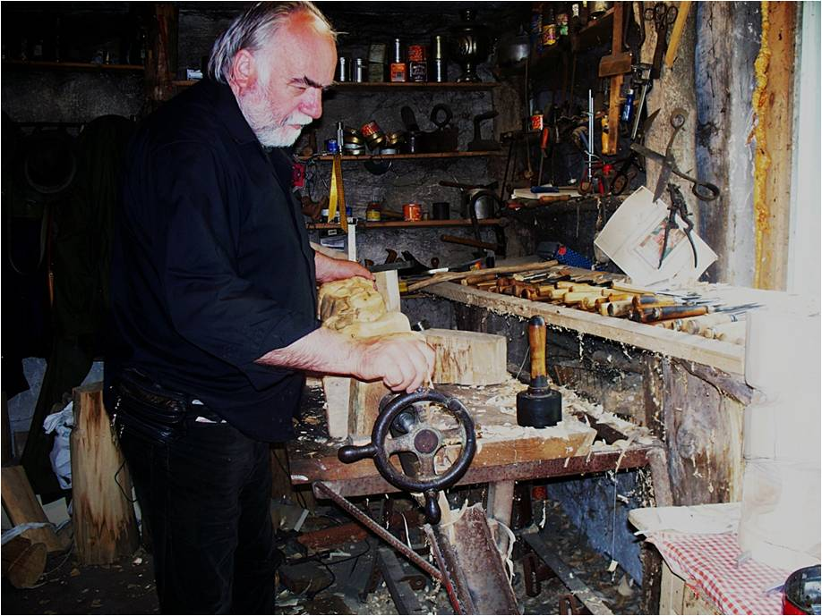
Ryszard Rebeszko

Slide 28
Mariusz Białecki

Slide 29
The participants of the Open Air Painting and Sculpting stay in Rodowo for two weeks. The masterpieces they make during their visit here remain in Rodowo forever and amuse us.

Slide 30
Walking down the street….

Slide 31
The Village of Miracles

Slide 33
Open window or door?

Slide 34
The dreams have shown Don Quixote the way to Rodowo!

Slide 35
Loud „miaw” wall

Slide 36
Come and visit us!!!

Slide 37
Karolina Langmesser, Karolina Łazarczyk. Natalia Jarmosz, Natalia Kępka, Patrycja Jarzynka, II-G

